Slide 1
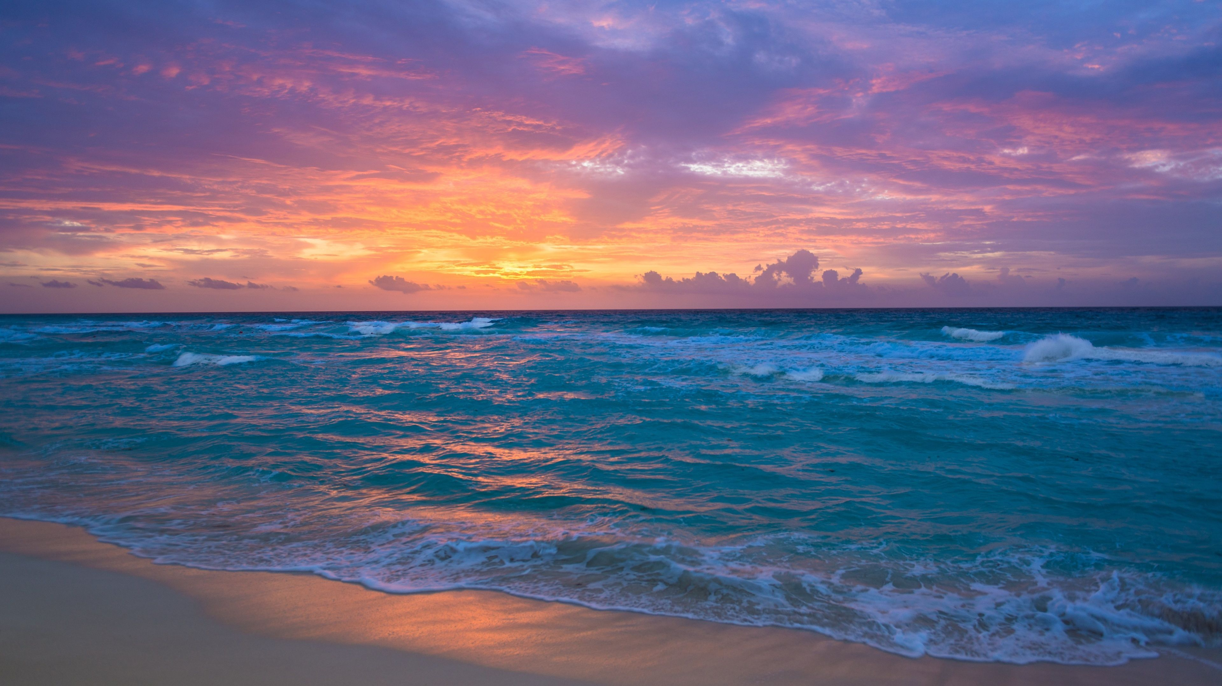
Capstone Project: RoboBoat Design Review 1
Tamara McCaskill, Bryson Potts, Manning Owens, Joseph Earnest, Steven Harrington

Slide 2


Presentation Overview
Introduction……………………………………………………………………………..1
Background……………………………………………………………………………..4
Customer Needs…………………………………………………………………….12
Functional Decomposition………………………………………………....17
Looking Ahead………………………………………………………………………..27
Tamara McCaskill 1

Slide 3
Who We Are
Bryson Potts
Team Lead
Tamara McCaskill
Builder
Joesph Earnest
Builder
Manning Owens
Builder
Steven Harrington
Programmer
FSU-PC 2021 RoboBoat Team
Tamara McCaskill 2

Slide 4
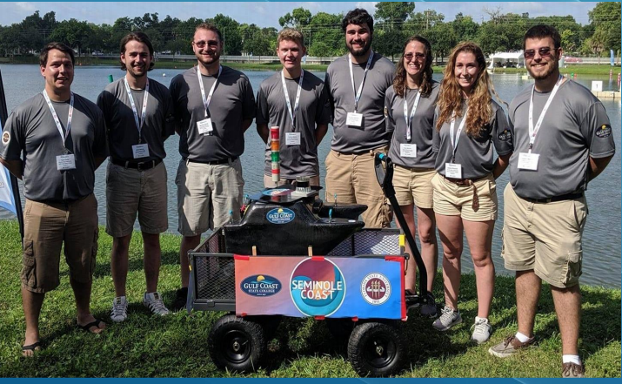
Who We Are Cont.…….
This will be our school’s second year entering the competition following in the footsteps of the 2019 team.
Tamara McCaskill 3

Slide 5
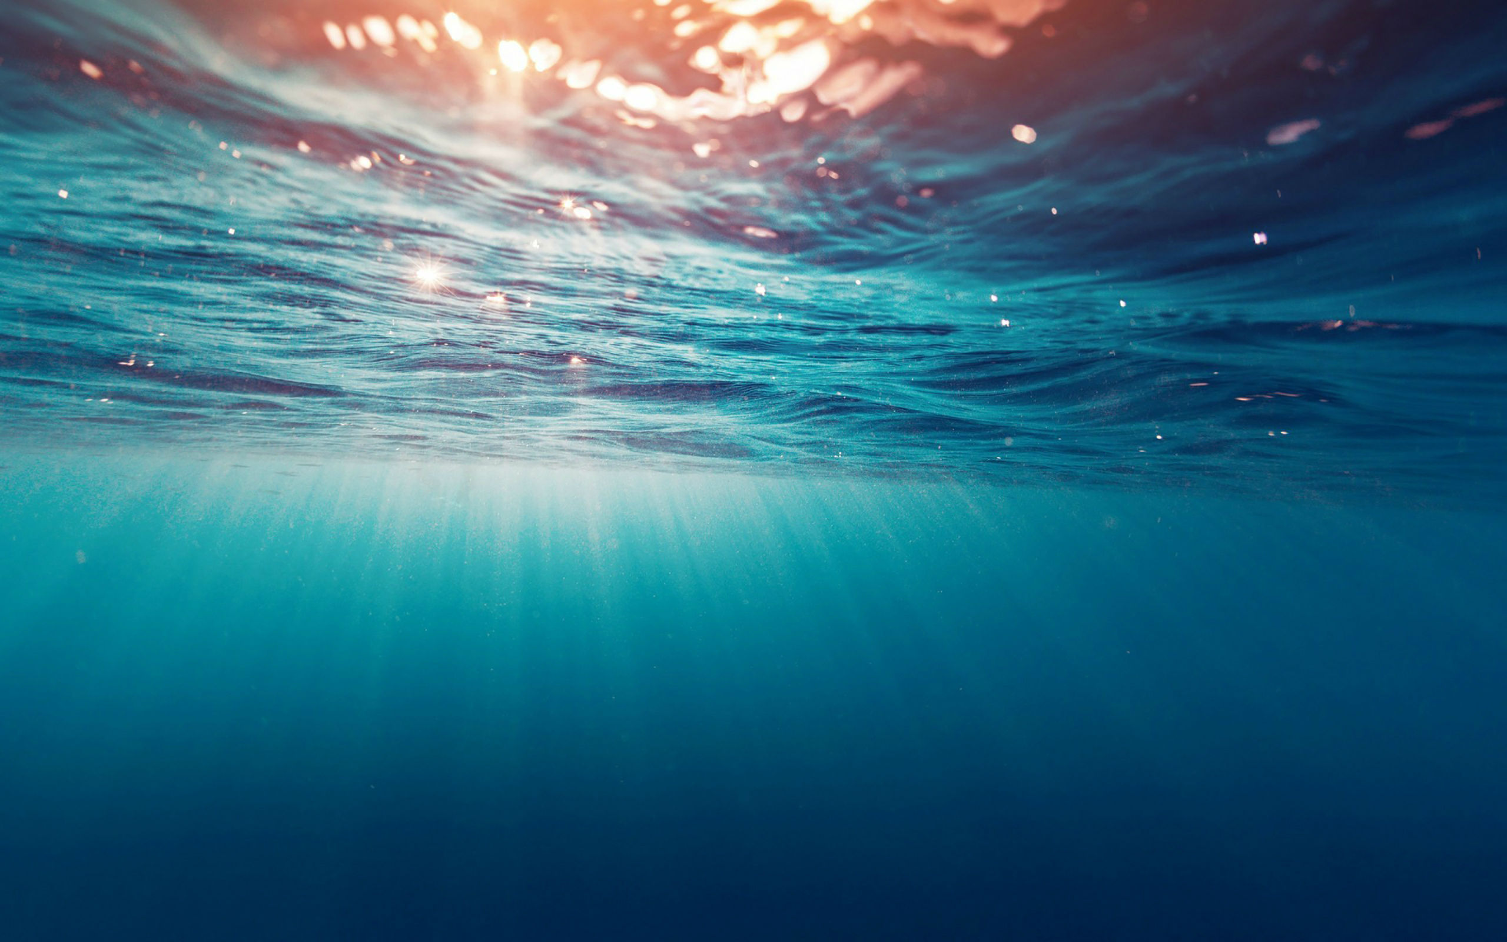

Project Background
RoboBoat is an international competition hosted by RoboNation in Daytona Florida.
Competitors create autonomous surface vehicles (ASV) to complete simplified real-world challenges.
Bryson Potts 4

Slide 6
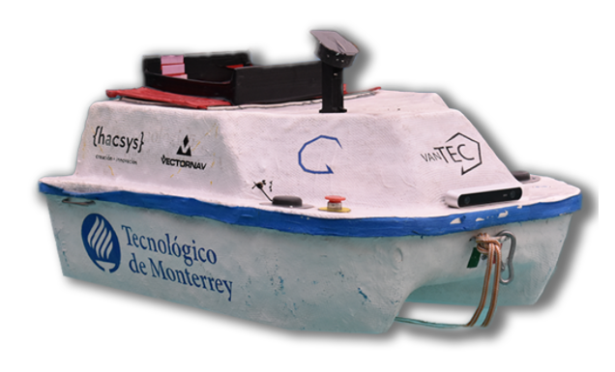
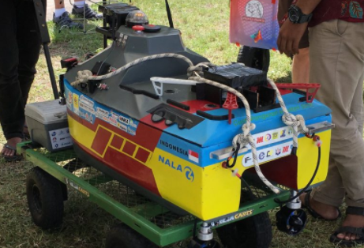
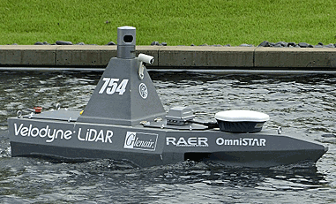
Project Background
Previous Overall Competition Winners
VANTEK 2020
Institut Teknologi Sepuluh Nopember 2019
Embry Riddle 2014
Bryson Potts 5

Slide 7
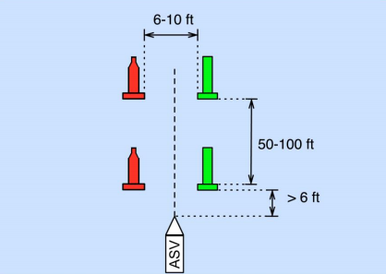
Project Background: Challenge 1
Mandatory Navigation Channel
The ASV navigates through two sets of gates.
Bryson Potts 6

Slide 8
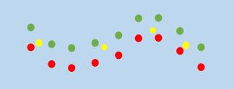
Project Background: Challenge 2
Obstacle Channel
The ASV navigates through more gates with buoys blocking the path at some points.
Bryson Potts 7

Slide 9
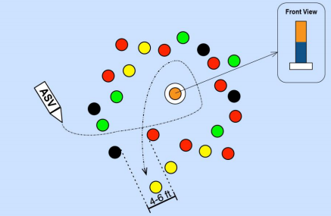
Project Background: Challenge 3
Obstacle Field
The ASV finds an opening in a field of buoys and circles the pill buoy, then exits the field of buoys.
Bryson Potts 8

Slide 10
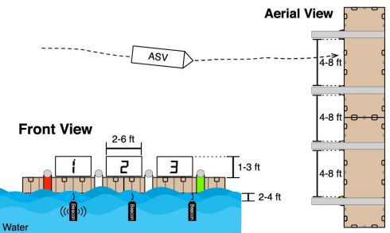
Project Background: Challenge 4
Acoustic Docking
The boat locates an underwater acoustic signal that will guide it to where it should dock and undock.
Bryson Potts 9

Slide 11
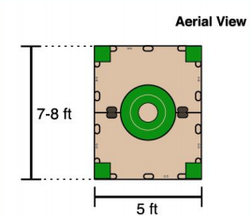
Project Background: Challenge 5
Object Delivery
The ASV delivers objects to specified delivery points. A UAV can be used to assist in the delivery
Bryson Potts 10

Slide 12
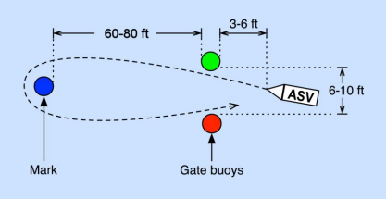
Project Background: Challenge 6
Speed Gate
The ASV passes through a gate of buoys, circles a buoy, then comes back through the initial gate as fast as possible.
Bryson Potts 11

Slide 13
Project Background: Challenge 7
Return to Dock
The ASV returns the initial docking point.
Bryson Potts 12

Slide 14
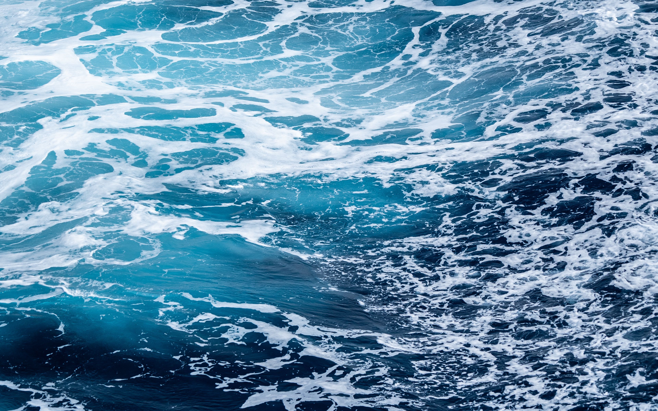
Customer Needs and Wants
• The customer needs play a critical part in the overall design and functionality of the boat.
• These customer needs provide us with constructive restraints that will need to be designed around our boat.
• Our customers are the advisors/sponsors that are assisting us to compete in the 2021 RoboBoat competition.
Manning Owens 13

Slide 15
Customer Needs and Wants
The following constraints are the 2020 RoboBoat competition rules.
1. It cannot exceed 140 pounds and would ideally be less than 70 pounds.
2. The vehicle cannot exceed six feet, by three feet, by three feet "box".
3. The competition takes place at a freshwater pond, but you will most likely be testing in saltwater conditions.
4. It is recommended the electrical components are covered.
5. Final demos are within the last two weeks of the summer semester, or if going to a competition plan to finish ideally a week before the competition.
Manning Owens 14

Slide 16
Customer Needs and Wants
The following constraints are the 2020 RoboBoat competition rules.
6. It will be transported in a pickup truck with a covered cab.
7. Focus on the areas of the competition that will net the most points with the least amount of complexity.
8. The vehicle needs to be battery powered.
9. The vehicle must be fully autonomous, and all decisions can be made onboard the ASV.
10. Any propulsion system is fine (thruster, paddle, etc.), but moving parts must have a shroud.
11. All sharp, pointy, moving, or sensitive parts must be covered and marked
Manning Owens 15

Slide 17
Interpreted Needs
Interpreted Needs are the engineering interpretation of the customer needs statements. The interpreted needs consist of the following:
1. The overall weight of the ASV and UAV will be less than 140 pounds.
2. The boat will fit into a six feet, by three feet, by three feet "box".
3. The boat will function as intended in both freshwater and saltwater.
4. Electrical components will be covered in case of inopportune weather conditions.
5. The team will decide whether the boat is planned to go to the competition or not.
Manning Owens 16

Slide 18
Interpreted Needs
The interpreted needs consist of the following:
6. The boat will be able to fit and be secured in the bed of the truck.
7. Focus on the categories of the competition that accumulates the most points.
8. The watercraft will be provided power by a cordless energy source.
9. The boat will be capable of making decisions and functioning independently.
10. The propulsion system will be determined by team preference, with a covering in case of moving parts.
11. The boat will have appropriate safety measures befitting of the RoboBoat standards.
Manning Owens 17

Slide 19

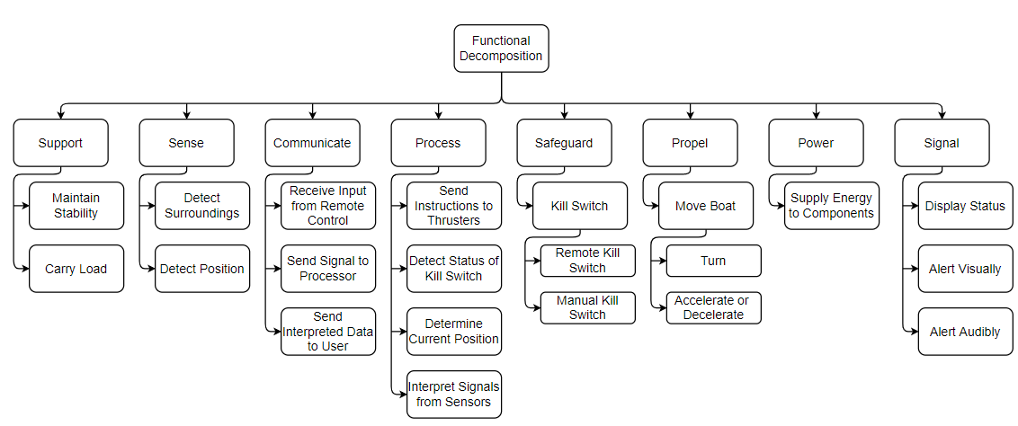
Functional Decomposition
Joseph Earnest 18

Slide 20
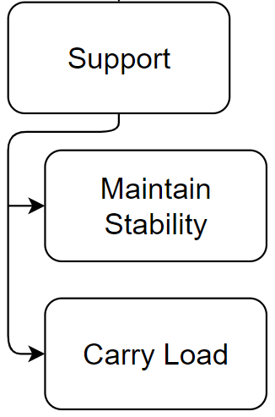
Functional Decomposition
Support
Maintain Stability
Hull Design
Buoyancy
Carry Load
Weight Distribution
Joseph Earnest 19

Slide 21
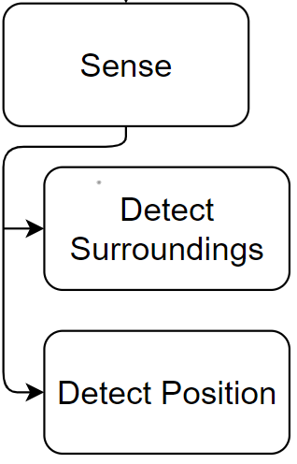
Functional Decomposition
Sense
Detect Surroundings
Detect Position
Joseph Earnest 20

Slide 22
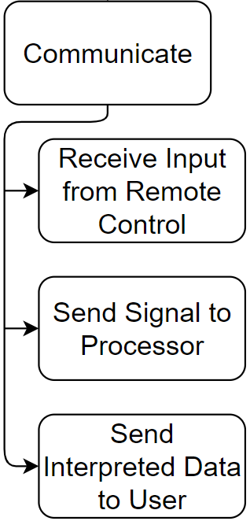
Functional Decomposition
Communicate
Receive Input from Remote Control
Send Signal to Processor
Send Interpreted Data to User
Joseph Earnest 21

Slide 23
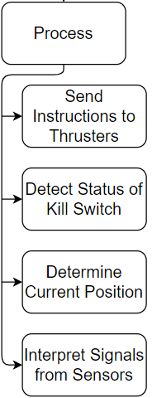
Functional Decomposition
Process
Send Instructions to Thrusters
Detect Status of Kill Switch
Determine Current Position
Interpret Signals from Sensors
Joseph Earnest 22

Slide 24
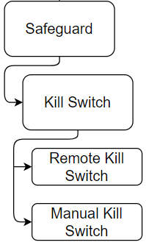
Functional Decomposition
Safeguard
Kill Switch
Remote Kill Switch
Manual Kill Switch
Joseph Earnest 23

Slide 25
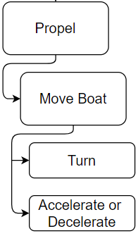
Functional Decomposition
Propel
Move Boat
Turn
Accelerate or Decelerate
Joseph Earnest 24

Slide 26
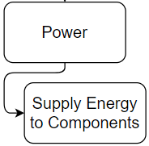
Functional Decomposition
Power
Supply Energy to Components
Joseph Earnest 25

Slide 27
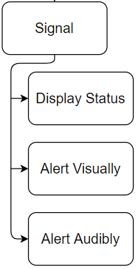
Functional Decomposition
Signal
Display Status
Alert Visually
Alert Audibly
Joseph Earnest 26

Slide 28

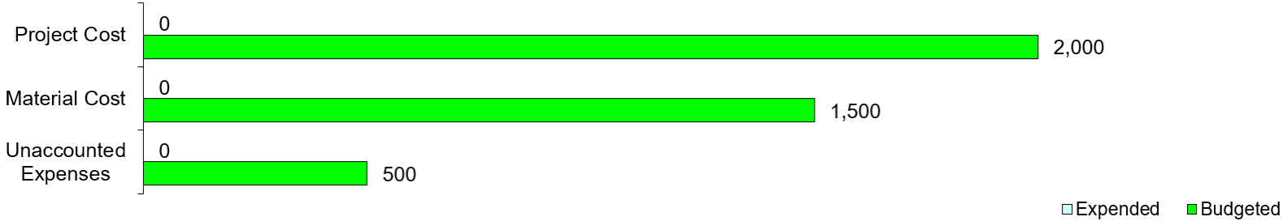
Budget
Steven Harrington 27

Slide 29
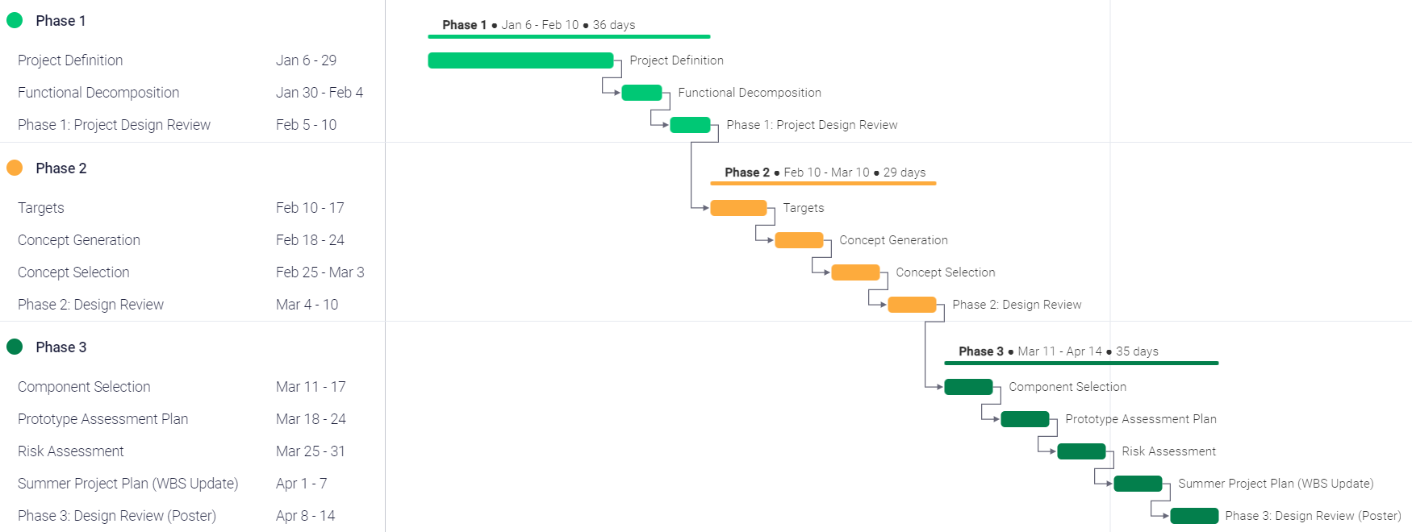
Looking Ahead
Steven Harrington 28

Slide 30
References
RoboNation. (2021). RoboBoat. RoboNation. https://robonation/programs/roboboat/
Steven Harrington 29

Slide 31
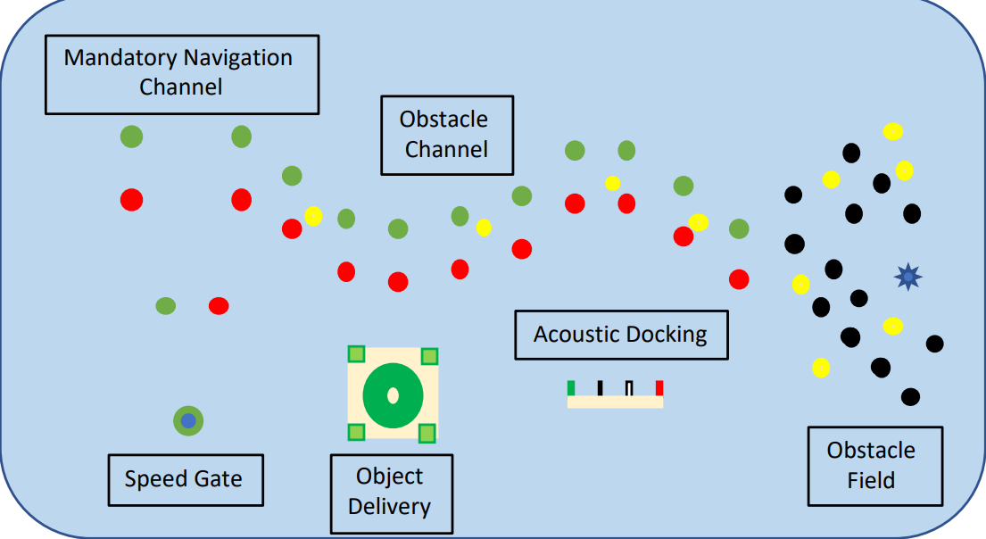
Questions?
30

